Slide 1
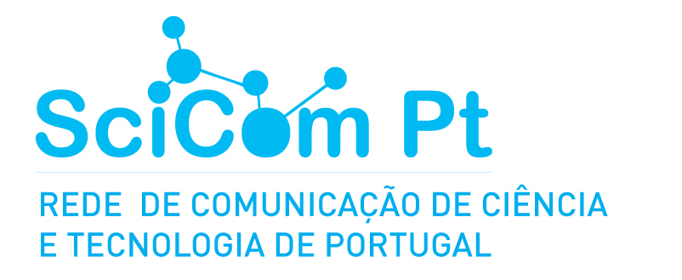
Science communication by scientists in Portugal
Marta Entradas, Inês C. Sousa & Feng Yan
CIES-Iscte
SciComPT Conference, May 8 – 10, Braga

Slide 2
Objective
To explore the perceptions of researchers working in Portuguese research institutions and universities about their role in science communication, identifying:
the communication channels they engage in;
audiences to whom their efforts are addressed;
the motivations for involvement in science communication activities;
the perceived influence of media channels on the public's opinion about science;
the desired level of public engagement in science.

Slide 3
Methods
We identified articles published by researchers in Portugal between 2010 and 2023 through Web of Science:
  Cleaned database for incomplete records and duplications – corresponding to 45.491 email addresses;
  Clean email list: repeated emails/personal emails (keep only institutional) - 29,879 institutional e-mail addresses;
Randomly selected 10018 emails;
Contacted 9062 researchers (excluding bounced emails).
Sampling
strategy
Survey distribution: 29 November 2023 and 8 February 2024

Slide 4
Methods
N=1573 (response rate 17.4%)
Gender: 53% are female
Institutions: 63% in public universities, 11% in polytechnic institutes
Sample
Field of research
Age
Career stage

Slide 5
Results
Q: “How many times in the past 12 months have you used the following channels to communicate with the non-specialist public?” (%)
Channels

Slide 6
Results
Q: “In the list below you will find a list of audiences outside the academy. How often have you engaged with each of them in the past 12 months?” (%)
Audience
N=1573

Slide 7
Results
Q: “Please indicate your level of disagreement / agreement with the following statements regarding science communication activities?”
Motivations
N=1573

Slide 8
Results
“Media channels are an integral part of everyday life and are used by almost everybody. How would you rate their influence on the public's opinion about science?”
Perceived influence of Channels
N=1573

Slide 9
Results
“Media channels are an integral part of everyday life and are used by almost everybody. How would you rate their influence on the public's opinion about science?”
Perceived influence of Channels
N=1573

Slide 10
Results
“Media channels are an integral part of everyday life and are used by almost everybody. How would you rate their influence on the public's opinion about science?”
Perceived influence of Channels
N=1573

Slide 11
Results
Q: “Please indicate your degree of agreement with the following statements that contain various opinions on the benefits of public involvement in science.
The public…”
Public Involvement
N=1573

Slide 12
Take-home Message
Face-to-face is the most frequent channel that scientists used to communicate with non-specialist public;
Scientists most frequently engaged with general public for science communication activities, followed by the schools;
The visibility of research in the media is one of the most important motivations for researchers’ science communication activities;
Communication by scientists has a very positive effect on the public’s opinion about science (followed by traditional media and then online media);
Scientists agree that participation in public discussion and/or debates on science and technology is the most desired way of public involvement.

Slide 13

Thank you
Feng Yan
feng_yan@iscte-iul.pt

